Slide 1
LOAN MANAGEMENT SYSTEM
SQL PROJECT BY
JENIFER G

Slide 2
MYSQL
What is SQL?
SQL (Structured Query Language):
A standard programming language used to manage and manipulate relational databases.
SQL allows users to interact with databases by executing queries, modifying data, and managing database structures.

Slide 3
SQL STATEMENT
DDL: Data Definition Language
DML: Data Manipulation Language
DQL: Data Query Language
DCL: Data Control Language
TCL: Transaction Control Language

Slide 4
SQL-DATA TYPES
DateTime
DATE
DATETIME
TIMESTAMP
TIME
YEAR
Numeric Datatype
INT
TINYINT
SMALLINT
MEDIUMINT
BIGINT
FLOAT
DOUBLE

Slide 5
String Datatype
VARCHAR(Size)
TINYTEXT(Size)
TEXT(Size)
MEDIUMTEXT(Size)
LONGTEXT(Size)
BINARY(Size)
VARBINARY(Size)

Slide 6
PROJECT Data sets
customer_income_status
loan_status
customer_info
country_state
region_info

Slide 7
SHEET 1- CUSTOMER INCOME STATUS
Import table - customer income status
Database creation
create database sql_project;
Use Database
use sql_project;
To classify customer’s income grades based on their applicant income.
Criteria for Classification:
Grade A: Applicant income > 15,000
Grade B: Applicant income > 9,000
Middle Class Customer: Applicant income > 5,000
Low Class: Applicant income ≤ 5,000

Slide 8
Criteria for Interest Calculation:
3% => Applicant income <5000 and Property_Area is rural
3.5% => Applicant income <5000 semi-rural
5% => Applicant income <5000 urban
2.5% => Applicant income <5000 semi urban
Otherwise =7%
New field creation based on interest:
Calculate monthly interest amt and annual interest amt based on loan amt
Create all the above fields as a table
Table name - customer interest analysis
(create this into a new table and connect with sheet 2 (loan status) bring the output)

Slide 9
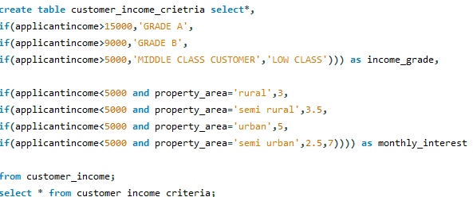

Calculate Monthly and Annual Interest Amounts​

Slide 10
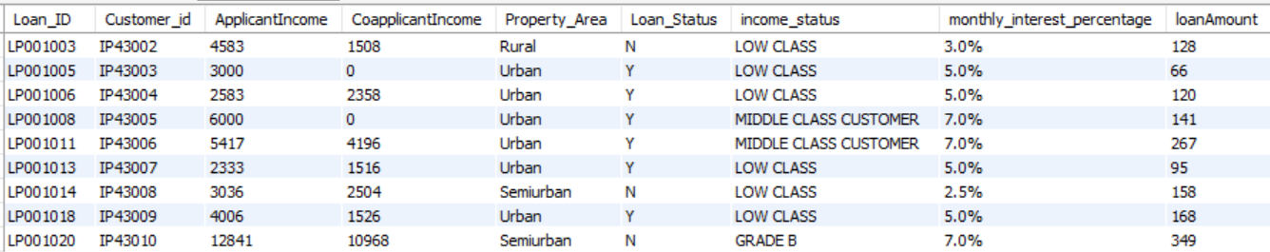
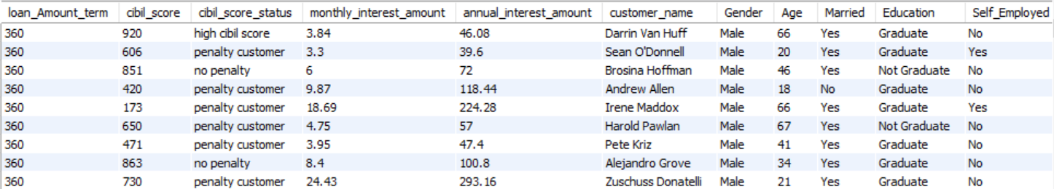
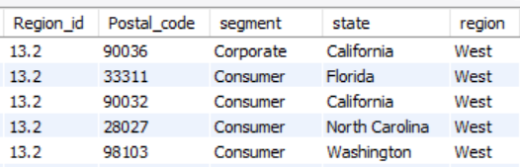

Output

Slide 11
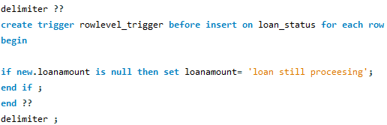
SHEET 2 - LOAN STATUS
Row level trigger Creation for loan amount
Criteria:
Loan Amount is null -> Status = loan still processing
Statement-Level Trigger creation for CIBIL Score
Criteria:
Cibil score >900 high cibil score
Cibil score >750 no penalty
Cibil score >0 penalty customers
Cibil score <=0 reject customers (loan cannot apply)

Slide 12
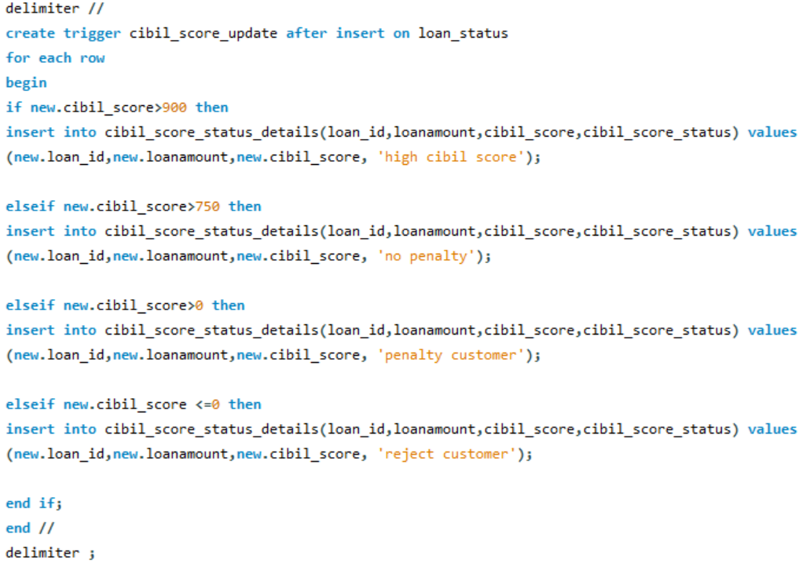

Slide 13
Delete the reject and loan still processing customers
Table creation - loan_cibil_score_status_details

Slide 14
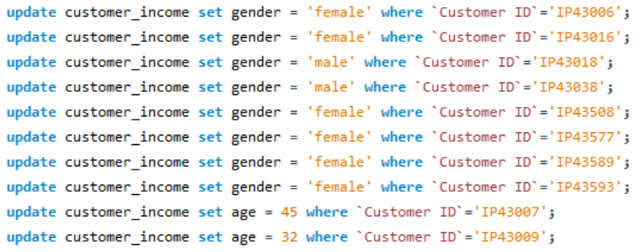
SHEET 3 - CUSTOMER INFO
Import the table
Update gender and age based on customer id

Slide 15
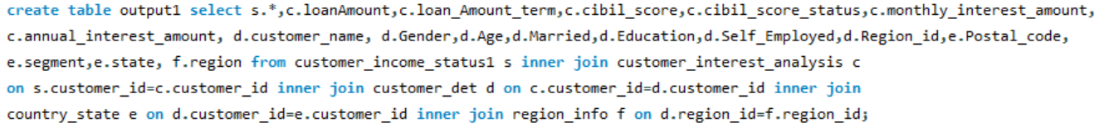
SHEET 4 AND 5- COUNTRY STATE AND REGION
Import the table
Join all the 5 tables
Find the mismatch details using joins
output

Slide 16
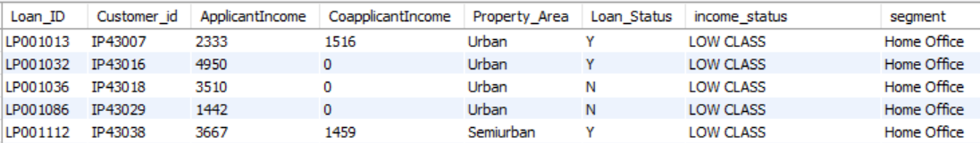
Filter home office and corporate
output

Slide 17
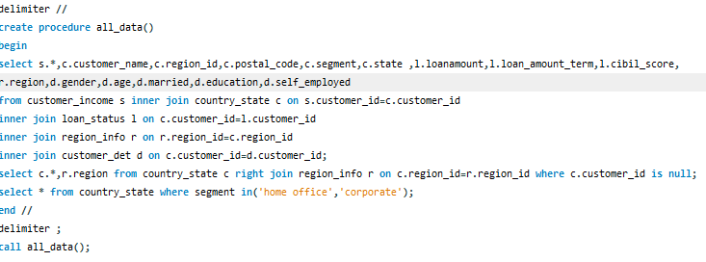
Store all the outputs as procedure

Slide 18
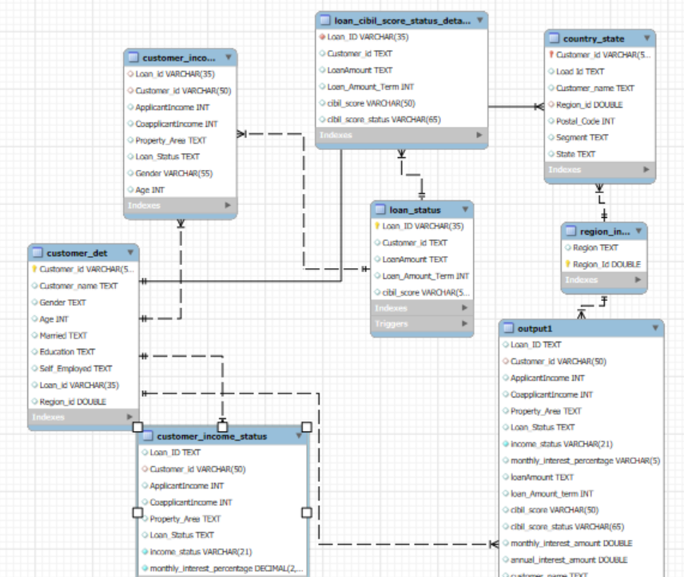
ENTITY-RELATIONSHIP (ER) MODEL
An Entity-Relationship (ER) Diagram is a visual representation of the entities in a database and their relationships. It helps in designing and structuring the database before actual implementation.

Slide 19

THANK YOU

